Slide 1


SQL Server Detective: Investigating Wait Statistics

Slide 2




Thank you to our AWESOME sponsors!

Slide 3



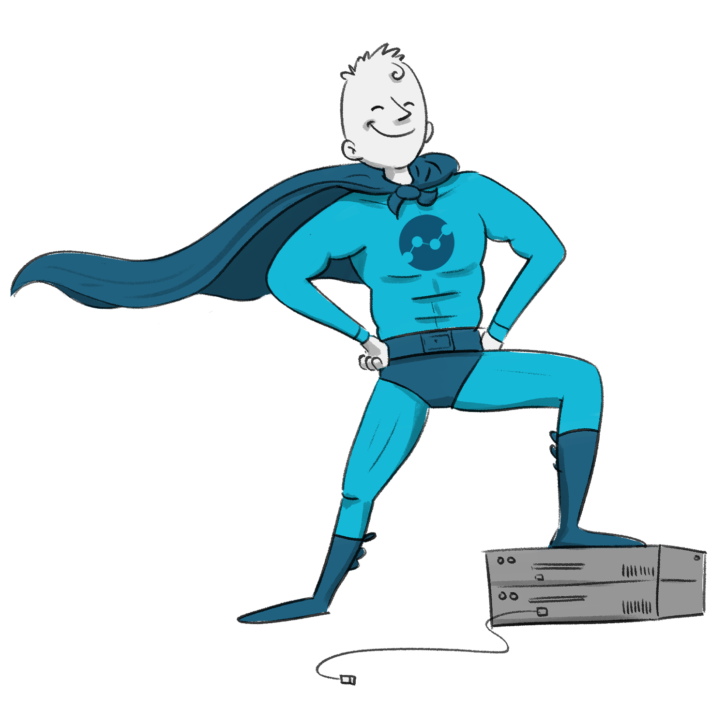

INTRODUCTION
Enrico van de Laar
Working with data in all shapes and sizes for 25+ years
Microsoft MVP alumni
Author
Speaker
Crazy Data Scientist
https://www.linkedin.com/in/enricovdlaar
enrico@dataheroes.nl
Notes:
Even wrote a book about Wait Statistics

Slide 4
AGENDA
Wait are wait statistics?
How wait statistics are generated
Querying & analysing wait statistics
Common wait types
Notes:
Even wrote a book about Wait Statistics

Slide 5
What are wait statistics?
When SQL Server executes a request but the resources are not available to complete the request a wait occurs
SQL Server records the time it has been waiting as wait time and what it has been waiting on as the wait type

Slide 6
What are wait statistics?
The wait time and wait type are logged at the instance level and are cumulative since last SQL Server start
The wait statistics will show you what your SQL Server instance is spending most of it’s time waiting on!

Slide 7
How wait statistics are generated
SQL Server uses schedulers to manage CPU time for threads
The number of schedulers = number of logical processors + 1 (DAC)
View schedulers using sys.dm_os_schedulers
Notes:
Demo schedulers

Slide 8
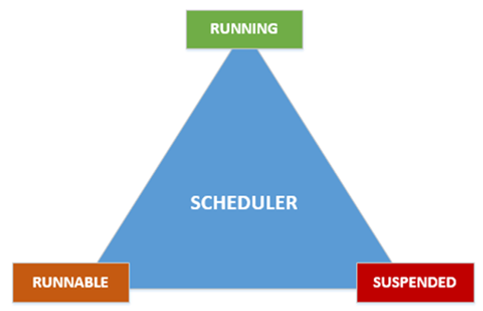
How wait statistics are generated
Notes:
Threads of een scheduler gaan door verschillende statussen heen, van Runnable naar Running en naar Suspended

Slide 9
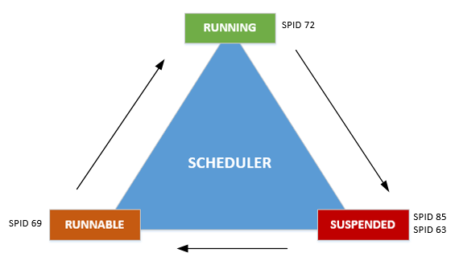
How wait statistics are generated
Signal wait time
Resource wait time
Runnable queue
Waiter list
Notes:
Afhankelijk in welke status de thread aan het wachten is ontstaat er verschillende wait time

Slide 10
How wait statistics are generated
Wait time
CPU time + Signal wait time + Resource wait time
Total execution time
Notes:
Totale query uitvoer tijd is dus op deze manier opgebouwd

Slide 11
Querying & analysing wait statistics
2 DMV’s for wait statistics:
sys.dm_os_wait_stats
sys.dm_os_waiting_tasks
sys.dm_os_wait_stats cumulative wait times
Use sys.dm_os_waiting_tasks to find out what is waiting right now!
New since SQL Server 2016: Session recorded, query-based and Query Store recorded wait stats*
Notes:
Not always very accurate
Demo DMV’s etc

Slide 12
Querying & analysing wait statistics
Some wait types will log additional information in sys.dm_os_waiting_tasks that will help you troubleshoot!
Others you can safely ignore like LAZYWRITER_SLEEP (your mileage may vary)

Slide 13
Querying & analysing wait statistics
Sys.dm_os_wait_stats perfect way to capture wait statistics baselines!
Without a baseline there is no way of saying a specific wait time is too long!

Slide 14
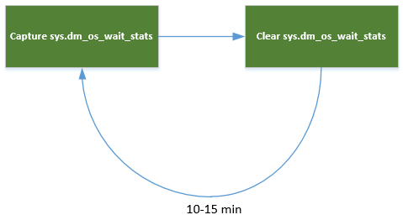
Querying & analysing wait statistics
Wait statistics baseline methodology

Slide 15
Querying & analysing wait statistics
Use sys.dm_os_waiting_tasks to find out what is slowing you down right now
Compare the wait times to your baseline
Focus on large increases or decreases for the top n wait types
Don’t freak out!

Slide 16
Common wait statistics
CXPACKET
SOS_SCHEDULER_YIELD
LCK_M_xx
PAGEIOLATCH_xx
OLEDB
THREADPOOL

Slide 17
Common wait statistics
CXPACKET
CXPACKET waits always occur when you use parallelism (MDOP)
Investigate execution plans, tune MDOP cost threshold, check statistics
Don’t freak out and turn of parallelism!
Since SQL Server 2016 SP2 changes have been made in how this wait type is reported
Notes:
Changed in SQL Server 2016 SP2, 2017 CU3
Demo

Slide 18
Common wait statistics
SOS_SCHEDULER_YIELD
Recorded whenever a thread has so yield from the scheduler due to its quantum (4 ms) being depleted
Does not return to the waiter list and goes directly to the runnable queue
Happens normally all the time
Can be cause of more investigation when values are higher than normal
Notes:
Demo

Slide 19
Common wait statistics
LCK_M_xx
LCK_M_xx waits occur when blocking is occurring
Check if there is a blocking bottleneck, break up large updates, change isolation level
Notes:
Demo

Slide 20
Common wait statistics
PAGEIOLATCH_xx
Latches are synchronization objects for buffer pages
PAGEIOLATCH_xx occurs when data is moved from disk to the buffer cache
Can indicate IO subsystem or memory issues, check indexes, statistics
Notes:
Demo

Slide 21
Common wait statistics
OLEDB
OLEDB occurs when SQL Server calls the Microsoft SQL Native Client OLE DB provider
Will also occur when you are using linked servers
DBCC commands will also generate OLEDB waits!
Notes:
Demo

Slide 22

Common wait statistics
THREADP L
THREADPOOL waits occur when there are no free worker threads available
Max nr. of worker threads (64bit): <= 4 CPU’s = 512 > 4 CPU’s = 512 + ((CPU’s – 4) * 16)

Slide 23
Common wait statistics
THREADP L
Can be caused by blocking, large query batches, increased number of user connections or large number of concurrent parallel plans
Check causes above before changing max worker threads!!!
Notes:
Demo

Slide 24
Questions?

Slide 25
Thank you to our AWESOME sponsors!

